Slide 1
Umbowo pamusoro pekusadaira kumishonga kweHIV

Slide 2
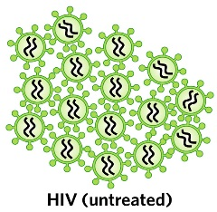
Kusadaira kumishonga zvinorevei?
Apo munhu anobatira hutachiwana hweHIV, hutachiwana hwunopinda mumuviri wemunhu hwotanga kugadzira zvifananidzo zvakafanana naihwo.

Slide 3
Kusadaira kumishonga zvinorevei?
Mishonga inoshandiswa kurapa HIV inonzi antiretrovirals (ARVs).
Notes:
Kazhinji kutora maARV nemazvo zvinoreva kutora mhando nhatu dzakasiyana dzemishonga yema ARV, nekuti zvinotora mushonga unodarika umwe wemaARV kumisa HIV kugadzira zvifananidzo zvakafanana nahwo.

Slide 4
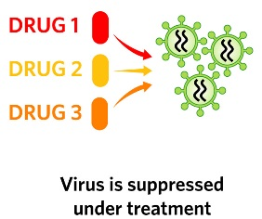
Kusadaira kumishonga zvinorevei?
Kana akatorwa nemazvo, maARV anomisa hutachiwana kuti husagadzira zvifananidzo zvakafanana naihwo uye zvinobatsira vanhu vane HIV kuti vanzwe zvirinane uye kuti vararame kwenguva refu.

Slide 5
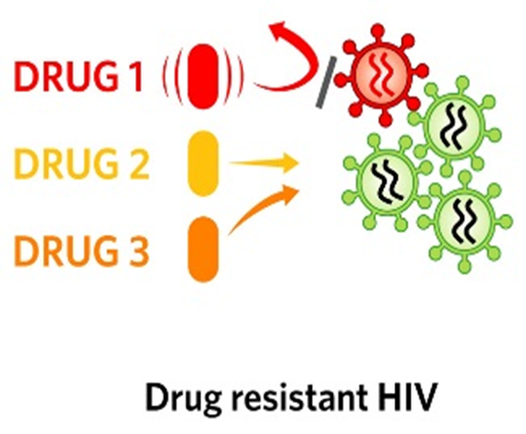
Zvisinei, maARV haana kuperera, uye nedzimwe nguva haakwanise kumisa hutachiwana hwose hweHIV kubva mukugadzira zvifananidzo.
Kusadaira kumishonga zvinorevei?

Slide 6
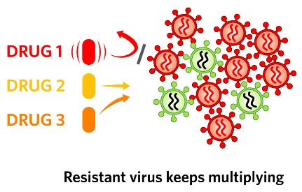
Kana izvi zvaitika, HIV inokwanisa kuramba ichigadzira zvifananidzo zvakafanana naiyo inonzi “haidairi kumishonga”.
Kusadaira kumishonga zvinorevei?

Slide 7
Sei kusadaira kumishonga yema ARV riri dambudziko?
Kana kusadaira kumishonga kwaitika, munhu anofanira kumira kutora ARV isingachashandi uye otanga kutora mhando yemushonga we ARV wakasiyana.

Slide 8
Sei kusadaira kumishonga yema ARV riri dambudziko?
Nekuda kweizvi, munhu ane HIV isingadaire kumishonga anesarudzo shoma dzemishonga yemaARV yaanogona kutora kubatsira kurarama zvakanaka.
Zvekare, vanogona kutapurira vamwe hutachiwana husingadaire kumishonga.

Slide 9
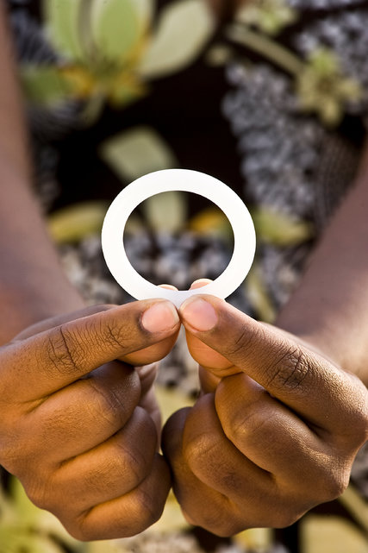
Sei kusadaira kumishonga yemaARV iri shungurudzo mutsvakurudzo ino?
Ring yemunzira yesikarudzi yemudzimai ine ARV inonzi Dapivirine. Dapivirine iri kushandiswa kudzivirira HIV chete, uye haishandiswi kurapa vanhu vane hutachiwana hweHIV.

Slide 10
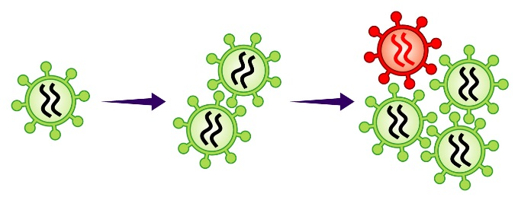
Sei kusadaira kumishonga yemaARV iri shungurudzo mutsvakurudzo ino?
Zvisinei, kana mudzimai akabatira HIV uye akaramba achishandisa ring, hutachiwana huri mumuviri make hunogona kusadaira kudapivirine uye kumishonga yakafanana yemaARV inoshandiswa kurapa HIV kana kudzivirira kutapuriranwa kwe HIV kubva kunamai kuenda kumwana.

Slide 11
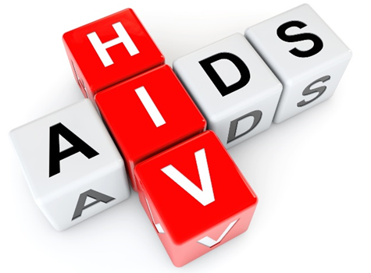
Ko kusadaira kumishonga yemaARV kungadzivirirwa sei apo muri mu HOPE?
Dzivirira kubatira HIV: Kusadaira kumishonga yema ARV hakukwanisi kuitika kumunhu asina HIV.
Notes:
Kune zvinhu zvakawanda zvamunokwanisa kuita kuderedza njodzi yenyu ye HIV:

Slide 12
Ko kusadaira kumishonga yemaARV kungadzivirirwa sei apo muri mu HOPE?
Shandisai ring ye dapivirine yemunzira yesikarudzi yemudzimai nguva dzose.
Shandisai makondomu nemazvo.

Slide 13
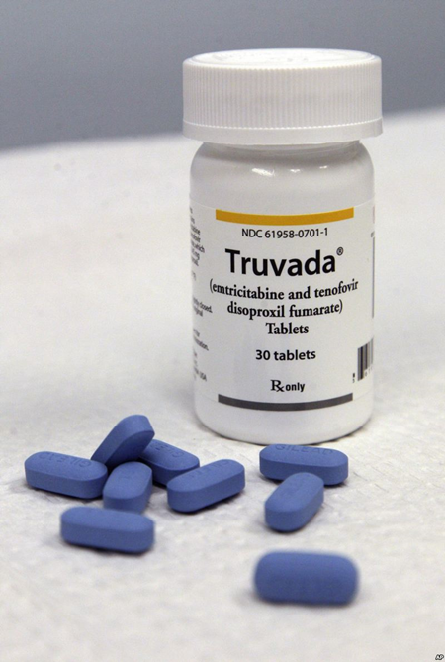
Ko kusadaira kumishonga yemaARV kungadzivirirwa sei apo muri mu HOPE?
Shandisai mushonga wekunwa wekudzivirira kubatira hutachiwana hweHIV (PrEP) (semuenzaniso Truvada)
Deredza huwandu hwevamwe vako vepabonde
Ita hunhu hwepabonde hunenjodzi yakaderera.

Slide 14
Ko kusadaira kumishonga yemaARV kungadzivirirwa sei apo muri mu HOPE?
Kana uine chirwere chepabonde, rapiwa
Kurudzira umwe wako kuti aongororwe HIV
Kana umwe wako aine HIV mukurudzire kuti anwe mishongayema ARV sezvavakarairwa.
Notes:
Bvunza chipangamazano wako nezve "umbowo pamusoro pedzimwe nzira dzokudzivirira HIV" zvinyorwa zveumwe umbowo hwakapamhidzirwa pamusoro penziraidzi.

Slide 15
Ko kusadaira kumishonga yemaARV kungadzivirirwa sei apo muri mu HOPE?
2. Ongororwai HIV nguva nenguva:
Kuongororwa HIV kuchaitwa pakushanya kutsvakurudzo kwega kwega.
Munofanira zvekare kuuya kukiriniki kuzoongororwa HIV kana muchifungidzira kuti mungange makabatira HIV pakati pekushanya.

Slide 16
Ko kusadaira kumishonga yemaARV kungadzivirirwa sei apo muri mu HOPE?
Kana ongororo yaratidza kuti mune HIV, zvakakosha kukurumidza ipapo ipapo kumira kushandisa ring yemunzira yesikarudzi yemudzimai kubatsira kudziirira kusadaira kumushonga.
Notes:
Kana kushanya kutsvakurudzo kukasaitwa, ari mutsvakurudzo anogona kubatira HIV, osazviziva,uye oramba achishandisa ring. Izvi zvinogona kukonzera kusadaira kumishonga imwe yemaARV.

Slide 17
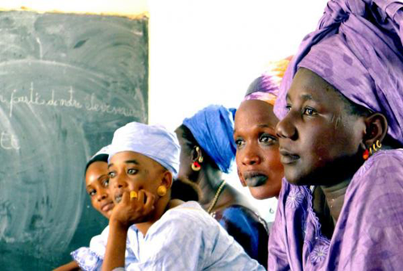
Ko kusadaira kumishonga yemaARV kungadzivirirwa sei apo muri mu HOPE?
3. Musagoverane maring emunzira yesikarudzi yemudzimai:
Varimutsvakurudzo yeongororo vanoongororwa hutano nekuongororwa HIV nguva nenguva.
Vanhu vasiri mutsvakurudzo havawani ongororoidzi dzeutano.
Vanhu ava vanogona kuve neHIV, uye vosazviziva.
Notes:
Kana vanhu vane HIV vakashandisa ring yemunzira yesikarudzi yemudzimai, izvi zvinogona kukonzera kusadaira kumishonga yeamwe maARV.

Slide 18
Kana muine mibvunzo kana kuti muchida umwe umbowo, tapota shanyai kukiriniki ye tsvakurudzo
Notes:
Vashandi vetsvakurudzo varipano kubatsira
Vashandi vetsvakurudzo varipo kukupai umbowo uye kupangamazano varimutsvakurudzo, vamwe vavo, uye vamwe vemunharaunda nezvekusadaira kumishonga nemimwe mibvunzo kana zvavangango shungurudzika nazvo.

